Slide 1

Welcome to QADMNFBD Fundamentals of BIG Data
3 Day Course
09.30 – 11.00
11.15 – 12.30
13.30 – 15.00
15.15 – 16.30
Dr. Vicky Crockett
Data and AI Principal Learning Specialist

Slide 2
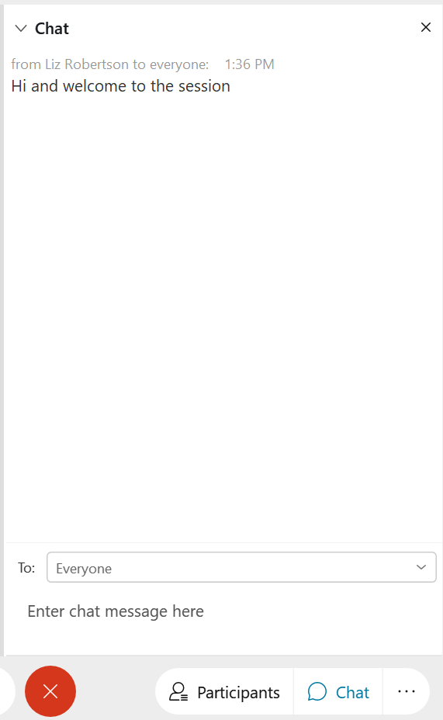
CHAT WINDOW
Ask & Answer Questions
Add Comments
Notes:
For a more integrated experience during Attend from Anywhere sessions, I’d encourage you to speak as if you are in the room with us rather than using the chat function.

Slide 3
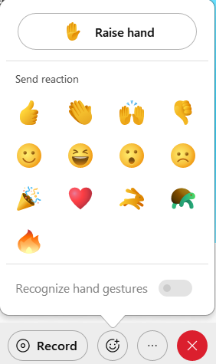
REACTIONS
And
RAISED HANDS
Finding a topic interesting?
Got a Question?

Slide 4
Troubleshooting
If I Disconnect
Please don’t leave the session
If you Disconnect
Re-join using your link
Contact
Chat link from your joining email
0203 908 2376
virtual.learningteam@qa.com

Slide 5



Annotation Tools LEFT SIDE OF SCREEN
Click Annotation Tools
Arrow Tool
Text Tool
Ticks & Crosses
Text Colour Change

Slide 6
Grab a lane - it’s yours for the day! Test out the Annotation Tools
1
2
3
4
5
6
7
8
9
10
11
12

Slide 7
Questions? Please just ASK

Slide 8
Learning Outcomes
You will know about:
The Fundamentals of Data Science
Different data models
NoSQL database
Different types of NoSQL databases
Hadoop
Spark
You will be able to:
Speak the language of Data Scientist
Use Python's native data bases
Query NoSQL databases using Python APIs
Perform big data analysis using Hadoop and Spark

Slide 9
Course materials

Slide 10
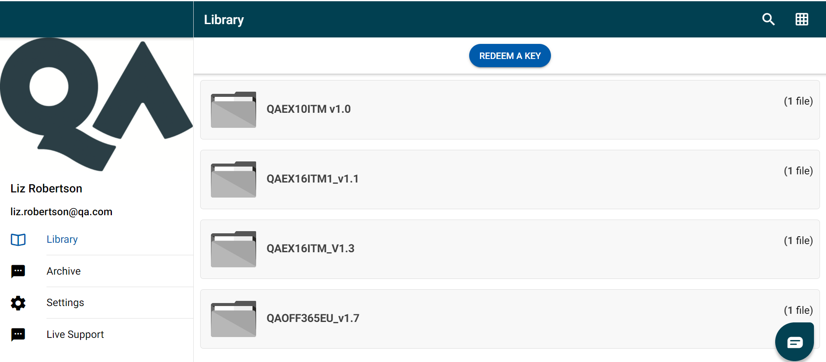
www.mimeo.digital/#/
Create Account
REDEEM A KEY:
DIGITAL
COURSEWARE

Slide 11
TOOLS
Anaconda
Bundle of analytics & science-based tools for python
Includes python & jupyter notebooks
Recommend:
https://www.anaconda.com/products/individual
Courseware on Jupyter notebooks will be made available to you in a zip

Slide 12
INTRODUCTIONS

Slide 13
It’s all about YOU
Name
Where do you work?
Knowledge and Experience
Your aims for the course?

Slide 14
What Sector do you work in…?
Government
Sales
Healthcare
Finance
Charity
Other
Transport
Education
IT

Slide 15
YOUR EXPERIENCE
Basic
Intermediate
Expert

Slide 16
What are your Objectives for the event?
1
2
3
4
5
6
7
8
9
10
11
12

Slide 17
What are your Objectives for the event?
1 |  | 11
2 |  | 12
3 |  | 13
4 |  | 14
5 |  | 15
6 |  | 16
7 |  | 17
8 |  | 18
9 |  | 19
10 |  | 20

Slide 18
Let’s Get Started…

Slide 19
Course overview
Day 1 : Introductons, Concepts & Python
Module 1: Introduction to Data Science
Module 2: Introduction to Big Data
Module 3: Python Review
Module 4: Pandas
Day 2: Engineering
Module 5: Big Data Choices
Module 6: NoSQL & Mongo
Module 7: Spark & Hadoop
Module 8: Event Systems
Day 3: Analysis
Module 9: Big Data Analysis & Machine Learning
Module 10: Graph Analytics & Neo4j

Slide 20
Day 1
Introductons, Concepts & Python
Module 1: Introduction to Data Science
Module 2: Introduction to Big Data
Module 3: Python Review
Module 4: Pandas
Breaks: 11-11.15, 12.30-1.30, 15.00-15.15
or as needed.

Slide 21
Module 1: Introduction to Data Science
The Topic: What?
An introduction to the unique job of a "Data Scientist"
Their motivations, skills and talents
Why this role is increasingly important
Applications: Why?
To better understand whether you want to become a data scientist
To work with colleagues who are data scientists
To judge whether your team (, organization) could benefit from data science
Expectations: Who?
Nothing is assumed about your background.

Slide 22
Introduction to data science
Discussion Together (10 mins):
Why are we talking about Data Science?
What is different about technology today?
What is different about human behaviour?
What different about data today?

Slide 23
Some example responses:
What is different about technology today?
Speed/processing-power of computer
you need to be able to process 1TB
Complex processing eg., over images
Graphics Cards (24 GB RAM)
What is different about human behaviour?
Internet, Mobile, ...
Lot's of user generated data
What different about data today?
Data Volume & Variety: type of data being captured
2010 -- 1 TB "big"
images
videos
user generated content
Data Velocity: The Internet, Mobiles, ...
esp. user-generated, user-monitored, user behaviour
Introduction to data science

Slide 24
Whiteboard collaboration (10 mins):
What is Science (vs., Art, Politics, ...)?
What is Science?
Prompts:
In what sense is science objective?
Are scientists biased?
What characterises The Scientific Method?
What aspects of The Method make it insenitive to bias and other issues?

Slide 25
What is science?
Some example responses:
In what sense is science objective?
objective may mean
(O) a topic: about physical vs., mental
(E) the type of conclusions: true OR false vs., taste
(B) bias: no stake in the outcome vs., stake in the outcome
science is only (E)
Are scientists biased?
scientists are biased, and may study mental phenomena (eg., pain)
eg., cancer researchers want to find a solution to cancer
What characterises The Scientific Method?
testing & refutation
experimentation
quantification & measure
etc.
What aspects of The Method make it insensitive to bias and other issues?
Testing & Refutation

Slide 26
What is data?
Q&A (5 mins):
How is the word "data" used in different areas of practice?
What does "data" mean in statistics?
What does "data" mean in computing ( & comp stats ) ?

Slide 27
What is data?
Example responses:
How is the word "data" used in different areas of practice?
many sense of data
evidence
clues
quantity & measure
observations
measurements of a (random) variable
software
int, float, str...
What does "data" mean in statistics?
numerical measurement of a random variable
What does "data" mean in computing ( & comp stats ) ?
"data" in computational statistics
statistical information you can process with a computer

Slide 28
What is (new about) data science
Q&A (5 mins):
What technical roles exist in organizations presently?
What kinds of problem do they tackle?
What sorts of problems do you think data scientists could help with?

Slide 29
What is (new about) data science
Example responses:
What technical roles exist in organizations presently?
Reporting: Data Analysts, Business Intelligence
Infrastructure: Database Administrators, DevOps, Data Engineers
Automation: Software Engineers
What kinds of problem do they tackle?
reporting: historical analysis
infrastructure: building pipelines and automated systems
automation: apps, business process, user interaction
What sorts of problems do you think data scientists could help with?
data scientists can solve probelms across
analysis, prediction, automation, infrastructure

Slide 30
What is the job of a data scientist?
Q&A (5 mins)
A data scientist helps with a wide class of open problems
What does a data scientist do differently?
What skills/techniques are used differently?

Slide 31
What is the job of a data scientist?
Example responses:
A data scientist helps with a wide class of open problems
many role profiles
What does a data scientist do differently?
a data scientist is an experimenter
whose primary tool is the computer
and whose primary aim is to explain and build real-world systems.
What skills/techniques are used differently?
a data scientist may use
statistics
programming
machine learning
big data
traditional data
... to solve unsolved problems

Slide 32
Whiteboard collaboration (10 mins):
What skills does a data scientist need?
What skills does a data scientist need?
Prompts:
What technical skills?
What mindset & behaviours?
What knowledge?

Slide 33
Some example responses:
statistics
mathematics
programming
software engineering
algorithms
relational data & querying
big data
sceptical (/disagreeable)
analytical
systematic
communication
domain knowledge
What skills does a data scientist need?
Prompts:
What technical skills?
What mindset & behaviours?
What knowledge?
(Industry agreed knowledge, skills, and behaviours can be found on the IfATE website)

Slide 34
What value does a data scientist add?
Discussion Together (10 mins):
What value does a data scientist add?
How might a data scientist impact existing teams?
What is unique about a data scientist skillset?
What projects would be executed primarily by data scientists?

Slide 35
What value does a data scientist add?
Example responses
How might a data scientist impact existing teams?
accelerate, complement, design
develop prototypes & test ideas
execute projects beyond skills of traditional analysis
apply traditional tools in non-traditional ways
eg., solving business problems with programs vs., with people
eg., modifying systems to collect more data
What is unique about a data scientist skillset?
cross-domain, cross-skillset knowledge
What projects would be executed primarily by data scientists?
research, prediction, big data analytitcs

Slide 36
Individual activity:
Where do you need to develop your skillset? (5 mins)
Alone, draw a skills profile chart using the notes as guidance.
Judge your current skillset /10, and draw a second line for your target skillset
Individual activity to be shared:
Consider your answers to the following questions before sharing with the group:
What problems do you find exciting? (10 mins)
Consider the problem areas which have been discussed in the session.
How might data science help?
Share ideas and problems from your role (or background) that may be helped with data science.
Estimated Time: 15 minutes
activity

Slide 37
Learning check
Think about your answers to these questions
What have you learnt from this session?
What is data science? What are data scientists?
Do you think being a data scientist is challenging?

Slide 38
End of Module 1
What is data science? What are data scientists?
data scientists are open problem solvers
who draw from any technical area they know
data scientists build software that
answers a problem or
automates the solution
Do you think being a data scientist is challenging?
data scientists learn constantly
always expanding their skills
always at the edge of new techniques
to solve new problems

Slide 39

Reminder: Take a break!
11.00 – 11.15
12.30 – 13.30
15.00 – 15.15

Slide 40
Module 2: Introduction to big data
The Topic: What?
An introduction to what big data is including:
Definitions
Challenges
Technology
Skills
Strategy
Applications: Why?
To better understand what skills need to be developed
To choose the right tools to suit organisational needs
To develop a strategy for working with Big Data
Expectations: Who?
Nothing is assumed about your background.

Slide 41
Q&A (5 mins):
What is a traditional data problem?
What skills are needed?
How is data stored?
What tasks are carried out/what problems are solved?
Traditional Data

Slide 42
Example responses
What is a traditional data problem?
Traditional problems are solved with business intelligence:
What skills are needed?
querying
reporting
exploration
How is data stored?
relational databases
SQL
What tasks are carried out/what problems are solved?
historical questions
SELECT AVG(profit) FROM results
facts
if the data is correct, the answers are correct
Traditional Data

Slide 43
So what is a Big data problem?
Quick Wikipedia answer to start with:
Big data refers to data sets that are too large or complex to be dealt with by traditional data-processing application software. Data with many fields (rows) offer greater statistical power, while data with higher complexity (more attributes or columns) may lead to a higher false discovery rate.^{[2]} Big data analysis challenges include capturing data, data storage, data analysis, search, sharing, transfer, visualization, querying, updating, information privacy, and data source.
big Data
Notes:
Big data - Wikipedia

Slide 44
Updated terminology for business use
Big Data
Big data engineering
Big data analytics
New terms that are needed to communicate the need for
new skills, tools, practices & methods

Slide 45
What do these terms signal to business?
Big Data
Non-traditional data systems and methods
Big Data Engineering
Injestion, structure, optimization, performance, configuring
Big Data Analysis
Modelling, computing, querying, using

Slide 46
challenges
Originally:
The volume of data
Now:
Real time analysis
Complex data structures

Slide 47
Q&A (5 mins):
What situations might require real time analysis?
Real time analysis
Inspiration:
Responsive interaction with customers
IOT devices working with sensor data

Slide 48
E-Commerce Example
Imagine a web store (eg., amazon)
The website wishes to monitor customer behaviour (eg., adding items to cart, leaving the website without purchasing, etc.)
monitor these REAL TIME
Respond to the "customer behaviour signals"
with some intelligent/adaptive response
offering discounts, alerting user, drawing user attention, ...
E-commerce example
Challenges:
each customer generates a significant amount of data
eg., mouse behaviour, click events, leaving & joining...
thousands of customers using the web store at the same time
analysis has to be fast, and responsive in real time
vs., a "traditional problem" which can be left to batch / over-night processing

Slide 49
Complex data structures
What type of data are more complex than traditional tables with rows and columns?
Some examples:
Tables with large/complex numbers of (interacting) fields
Images
Text
Audio

Slide 50
Image processing example
Satellite Image Analysis for Government and Charity Resource Tracking
Suppose we distribute resources via trucks/cars/etc. in a developing nation
Can we track the efficient/safe/reliable distribution of these?
Also, eg George Cloony: satellite image analysis for early warning of conflicts
Challenges
A single satellite image is GBs of data
Many images are needed to reconstruct a country/road-system, 10TB of data per view
Processing requires looking at a “view of the country” each day/week/etc.

Slide 51
Individual activity:
Investigate an example problem involving Big Data
Create a Mind Map or list of the challenges encountered
Share what you have found with the group
Estimated Time: 15 minutes (plus time for sharing)
activity

Slide 52
Defining Big Data: The Three V’s
Big Data is often defined using the 3 V’s:
Velocity
Variety
Volume
(Sometimes others are included: Veracity, Value, …)

Slide 53
Velocity
Velocity
real-time
problems "quickly" become non-traditional
traditional solutions do not scale well
response required < 1s
ratio = traditional-query-time / response-time
is this close-to or more-than 1?
eg., 60 seconds / 120 secods = 0.5
eg., 60 seconds / 30 seconds = 2

Slide 54
Variety
Variety
data complexity
problems "quickly" become non-traditional
traditional solutions do not scale well
independent dimensions in the dataset
independent attributes of the data
repeated information:
(lat, long), (address), (geotag)
large amounts of relevant non-repeated information
image: 1MP is 1,000,000
even a small image is 1-million dimensions
if you're considering >20 relevant, indepedent attributes, may have big-data problem

Slide 55
Volume
Volume
traditional solutions scale well
RAM
how much memory does a query need?
ratio = query-need / machine-amount
of the best plausible single machine
eg., 100 GB / 512 GB
not a big data problem
eg., 1 TB / 512 GB
could be a big data problem
may also be possible to optimize the query
Storage
how big is the entire dataset?
ratio = disk-size / machine-amount
eg., 10 TB / 16TB
not a big data problem

Slide 56
Defining big data: for analysts
Big Data Analysis:
Prediction
Explanation
And may use non-traditional data models: graphs, documents, …

Slide 57
Defining big data: for Engineers
Big Data Engineering:
Installing
Performance
Tools
Trade-offs local single-machine
Data centres
CAP theorem
Configure

Slide 58
What are non-traditional data models?
The traditional data model is the table. NoSQL is..
key-value pairs
loose structure
documents
hierarchy
graphs
order
column stores
1000s col
Schemaless
unstructured data
exotic:
time series dbs
matrices, linear algebra,
Often with big data problems, datasets will be stored in a non-tabular form -- even if, by the end, we have a table.

Slide 59
What is NoSQL?
Originally, "not sql", now, "not only sql".
Data systems, and data model (ie., structures), which are non-tabular and are not "natively" SQL-based.

Slide 60
How do I understand data models and queries?
The data model describes how the data is structured. The query brings together datasets, reshapes and summaries; ie., the query structures and processes.
There's a tradeoff: you can either structure data specific to a need, and make the query simpler & faster; or make the structure general, querying take longer.
Relational databases propose a universal data structure (ie., a table); but this can have negative performance implications if you're problem requires:
order,
sparcity,
heirachy,
extensive re-structuring.

Slide 61
What’s a table
{ (id, age, temp), ... }
{ (1, 20, 19), (2, 20, 30), ...}
table = set of rows
row = tuple of values

Slide 62
What are key-value pairs?
a single tagged value
{"id": 1}
datasets are bundles a single piece of data with a label
bag of
me: {"id": 1}, {"age": 20}, {"temp": 19}
you: {"id": 2}, {"age": 20}, {"temp": 30}

Slide 63
What are documents?
documents give you heirachy
using key-values in a more structured way
collection of key-value pairs
where each value can itself be such a collection
this enables modelling heirachical data
vs., tabular -- querying creates heiarchy
vs., tabular -- here, we store in a heiarchy
```
credit_file = {
"name" : "Michael",
"address": [("London", "UK"), ...],
"loan" : {
"amount": 1000,
"date": 1/1/1900
}
}
```

Slide 64
What are graphs?
graphs give you ordering between datasets ("rows")
data is stored in an order
eg., consider below, storing
eg., {(𝐴𝑙𝑖𝑐𝑒,(𝑀𝑖𝑐ℎ𝑎𝑒𝑙,𝐵𝑜𝑏)), (𝑀𝑖𝑐ℎ𝑎𝑒𝑙,()), (𝐵𝑜𝑏,(𝐴𝑙𝑖𝑐𝑒)), (𝐸𝑣𝑒,(𝐵𝑜𝑏))}{(Alice, (Michael,Bob)), (Michael,()), (Bob,(Alice)), (Eve,(Bob))}
ie., {(𝑁𝑜𝑑𝑒,𝑁𝑒𝑖𝑔ℎ𝑏𝑜𝑟𝑠)}{(Node,Neighbors)}
tables do not order data
querying has to impose order
therefore querying is more efficient if data is stored in an order
Michael -LIKES-> Alice <-LIKES-> Bob -LIKES-> Eve
who like Alice?
{Bob, Eve}

Slide 65
What’s a column store?
a table stored in column-form
compare with: { (id, age, temp), ... }
{ (1,2), (20, 20), (19, 30), ...}
table = set of columns
querying selects a subset of columns
so choosing, say, 20 / 2000 columns is efficient
eg., consider an image: that could be a 1million-col row

Slide 66
What’s a schemaless DB / data store?
Consider images: it is not efficient to store, as a row, a 1mil-col image.
Rather, leave it on the disk as a binary image file and while querying convert to a tabular (ie., a matrix) form.
This suggest a need for a storage system which imposes no consistent schema across datasets (ie., files); and leaves the query to do all the processing, including even imposing some basic structure.
This is just a file system!
A schemaless data store is then just a file system... a big data version will provide a file system across 100s+ machines.

Slide 67
Important examples of big data tools / techniques
schemaless ("object store")
hadoop (on-premise)
S3 amazon
Microsoft Object-Store
Google Cloud Storage
graph
neo4j
key-value
redis
document
mongo
...
columnar
cassandra
hbase

Slide 68
Individual activity:
Update your skills and knowledge profile chart using the notes as guidance (5 mins)
Where to you need to develop your skillset? (NB: your list may get longer before it gets shorter!)
Consider your answers to the following questions before sharing with the group:
What problems using Big Data do you find exciting? (10 mins)
Consider the problem areas which have been discussed in the session.
Share ideas and problems from your role (or background) that may be helped.
Estimated Time: 15 minutes
activity

Slide 69
Learning check
Think about your answers to these questions
Why does there need to be new definitions for Big Data?
What is Big Data to an Analyst? Or to an Engineer?
What problems might involve Big Data?
If there are any that you can’t confidently answer – please ask for a summary now

Slide 70
End of Module 2

Slide 71
If you are having any issues installing Anaconda please ask for help – it will be needed for module 3.
Anaconda
Bundle of analytics & science-based tools for python
Includes python & jupyter notebooks
Recommend:
https://www.anaconda.com/products/individual
Courseware on Jupyter notebooks will be made available to you in a zip
Reminder

Slide 72
Reminder: Take a break!
11.00 – 11.15
12.30 – 13.30
15.00 – 15.15

Slide 73
Module 3: Python review
The Topic: What?
A review of Python:
Using Jupyter notebooks
Introduction and handling data in Python
Selection
Iteration
Functions
Applications: Why?
To understand the necessity for using programming tools in Data Science
To better understand the capabilities of programming tools
Python is a good first language to develop your skills and has lots of ready written built-in methods for Data Science
Expectations: Who?
It is advised for this course that prior experience of Python is required. This module will give a fast paced review to ensure your prior knowledge is fresh in your mind and will plug any gaps in your knowledge that will be needed for later modules.

Slide 74
Using the courseware
For this module some delegates on the course may wish to move at a faster pace than the group.
To enable this, we will start by ensuring everyone can load and access jupyter notebooks containing the courseware for this module.
Some delegates may then be comfortable continuing with parts of this module independently, while others may prefer to work through at the pace of the group.
If you are moving at a faster pace:
Please still ensure that you check the course content carefully – eg there are data science specific examples, so don’t assume that you can skip selection/iteration/functions if you have experience of programming previously.
Please hold questions until the trainer is at the relevant point (or ask at an appropriate moment when everyone is completing practice or asking general questions).

Slide 75
What is Anaconda?
Anaconda is a collection of python packages, programms and other software for data analysis & data science.
What is jupyter notebook?
A notebook is a documentation or commentary-first style of programming, where the key elements are explanations & comments. The code is less important, and often only small amounts.
How do I start Anaconda?
Start Menu > Anaconda Navigator
Getting started

Slide 76

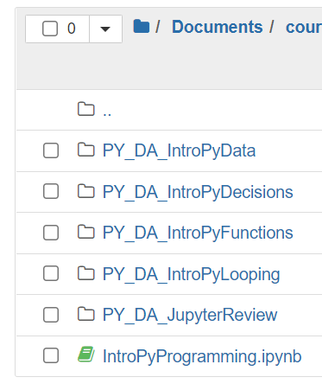
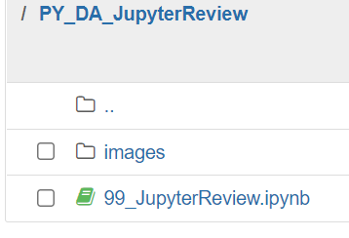
Jupiter Notebook can be launched from the Anaconda Navigator.
Once you have saved and unzipped the courseware in an appropriate location you can navigate within Jupyter Notebook to open a notebook – these have the file extension .ipynb
In the JupyterReview folder:
Open the notebook: ’99_JupyterReview.ipynb’
Please raise a hand in Webex when you have reached this point so no one gets behind. Please ask for help if you need it.
Using Jupyter Notebooks

Slide 77
Jupyter Review
- Trainer demonstration
Objectives
Start jupyter notebook
Create a new notebook
Rename a notebook
Add a text cell
Add a code cell
Run cells

Slide 78
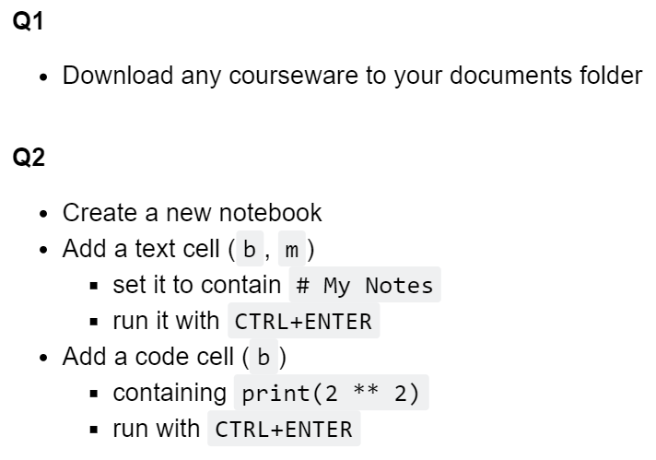
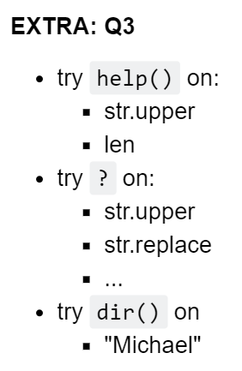
Jupyter Review
Exercise
Estimated time 5 minutes
Please raise a hand in Webex when you have reached this point so no one gets behind.

Slide 79
What is Python?
Python is programming language. Programming languages are a general "command language" for machines which can, in principle, command them to do whatever you need.
Most aren't specialized to any particular use case.
Educational use of the langauge was a major initial goal. So the syntax is design to read easily.
Why should I use Python?
Easier than other languages to "get started".
Python has a linear learning curve. For every week spent learning it, you get "one week of skill". But with other languages, it can easily take 6 months before you understand a basic program.
Python is free and open source. Free in two sense: it doesn't cost any more, and you free to use it however you wish.
Python is also either the most popular language in the world, or nearly so. And it is therefore receiving a lot of work, attention, support, etc.
In particular, python is where many new techniques, libraries, methods (etc.) are being provided. Eg., much of machine learning, data science, new forms of data analysis -- are being first developed in python.
Introduction to Python Programming

Slide 80
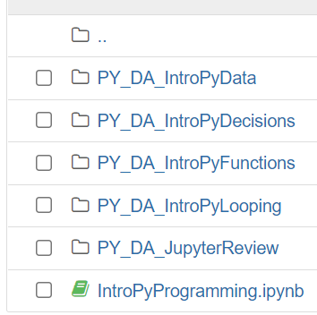
Refresh: Introduction to Python Programming
- Trainer demonstration
Part 1: Using Python
Part 2: Python Basics

Slide 81
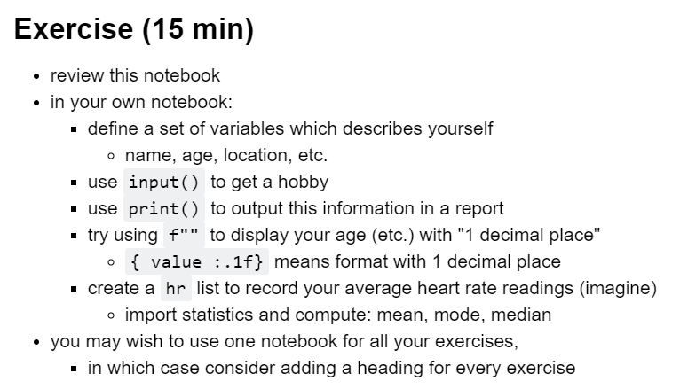
Refresh: Introduction to Programming in python
Exercise
Estimated time 15 minutes
Please raise a hand in Webex when you have completed this exercise.

Slide 82
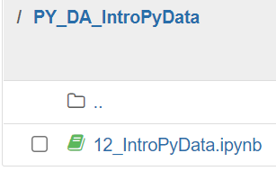
Refresh: Introduction to datasets
- Trainer demonstration
Part 1: Representing Data
Part 2: Working with Data

Slide 83
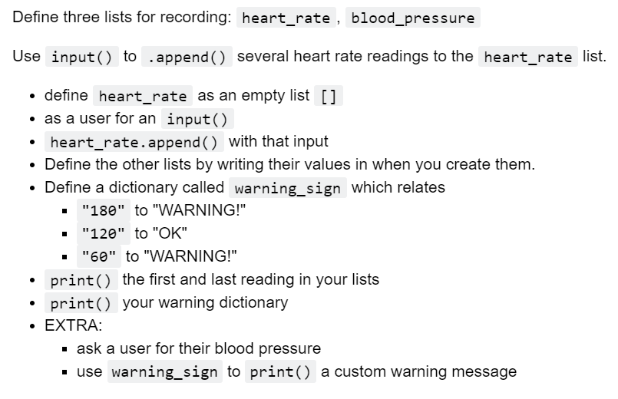
Part 1:
Your goal in this exercise is to simualte tracking health data for a user, and provide them with a custom health warning message if there are any issues with their health data
Refresh: Introduction to datasets
Exercises (slide 1 of 2)
Estimated time for both exercises: 30 minutes

Slide 84
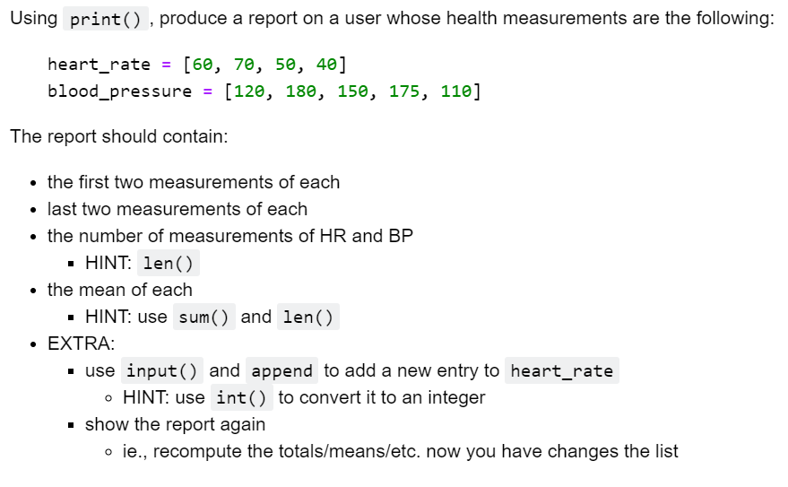
Part 2
Please raise a hand in Webex when you have completed this exercise.
Refresh: Introduction to datasets
Exercises (slide 2 of 2)
Example solutions can be found in the notebook

Slide 85
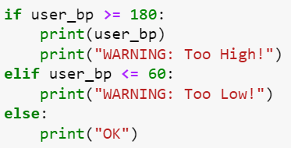
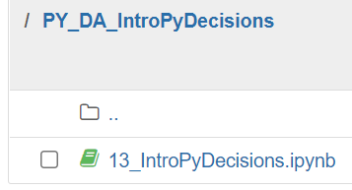
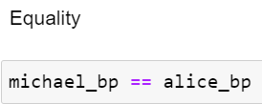
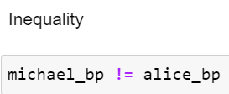
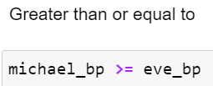
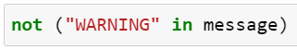

Selection structures
Example conditions
Example combinations
Refresh: Introduction to decision making
- Trainer demonstration

Slide 86
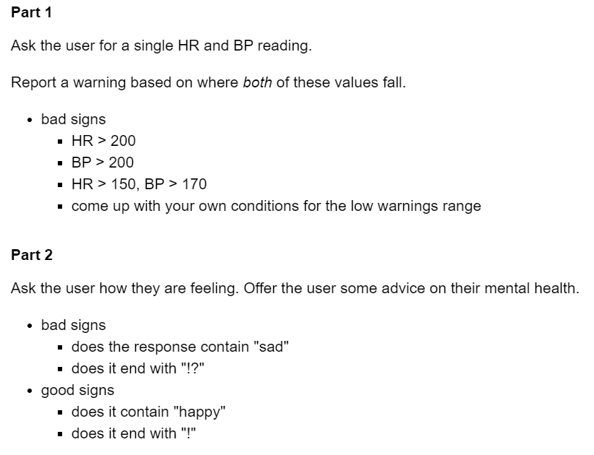
Your goal in this exercise is to simulate tracking health data for a user, and provide them with a custom health warning message if there are any issues with their health data.
Please raise a hand in Webex when you have completed this exercise.
Refresh: Introduction to decision making (selection)
Exercises
Estimated time: 20 mins
Example solutions can be found in the notebook

Slide 87
Reminder: Take a break!
11.00 – 11.15
12.30 – 13.30
15.00 – 15.15

Slide 88
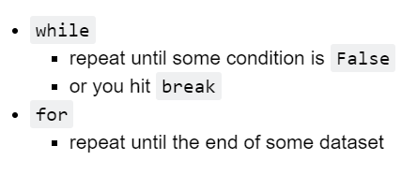
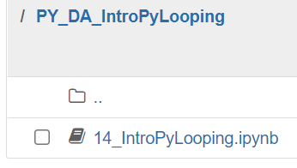
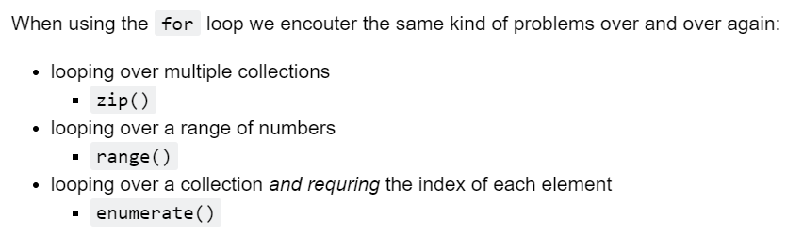
Part 1: Looping in Python
Part 2: Analysing Datasets using For
Refresh: Introduction to looping (iteration)
- Trainer demonstration

Slide 89
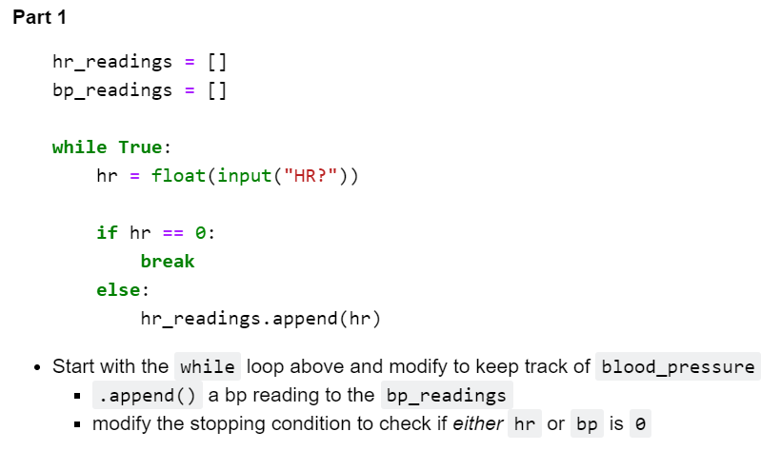
Your goal in this exercise is to simulate tracking health data for a user, and provide them with a custom health warning message if there are any issues with their health data.
In this exercise we will interactively ask the user for multiple measurements of the HR and BP then respond with a message for each.
Refresh: Introduction to Looping (iteration)
Exercises (1 of 2)
Estimated time for both parts: 20 minutes

Slide 90
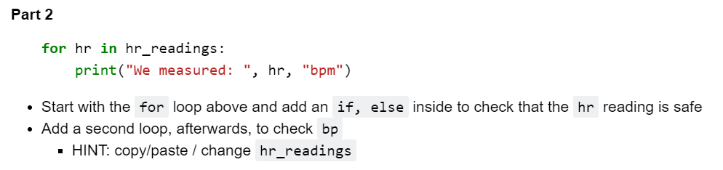
Your goal in this exercise is to simulate tracking health data for a user, and provide them with a custom health warning message if there are any issues with their health data.
In this exercise we will interactively ask the user for multiple measurements of the HR and BP then respond with a message for each.
Please raise a hand in Webex when you have completed this exercise.
Refresh: Introduction to Looping (iteration)
Exercises (2 of 2)
Estimated time for both parts: 20 minutes

Slide 91
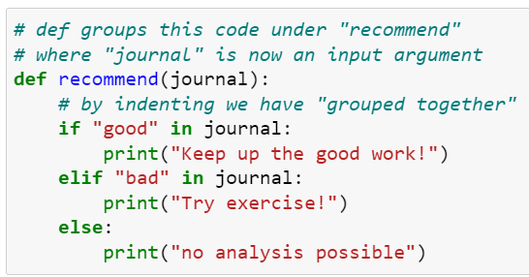
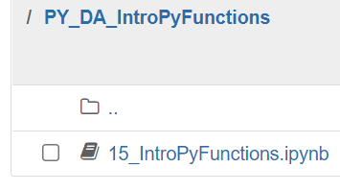
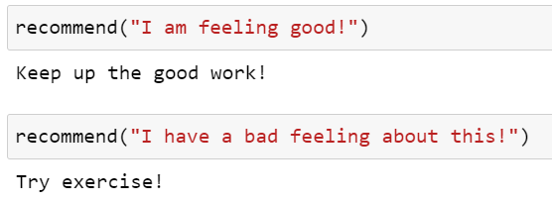
Subroutines are used to help structure code, for commonly repeated tasks, or to improve code readability.
Common confusion for those starting out: it won’t do anything unless called!
In python, many people refer to these subroutines as ‘functions’.
Strictly speaking, if data is returned then it is a function. However, python uses the same code structure to define procedures (which don’t return data) – like the example above.
Introduction to subroutines
Extra:

Slide 92
Introduction to subroutines
Some subroutines come ready made. It’s one of the advantages of using Python for Data Science that so much has already been created.
Which of these might you expect to return a value?
print()
help()
input()
len()
sum()
int()

Slide 93
Individual activity:
Update your skills and knowledge profile chart using the notes as guidance
Where do you need to develop your skillset?
Note: your list may get longer before it gets shorter – we hope you’ll have learnt lots, but still have lots of ideas for further study by the end of this course!
Estimated Time: 10 minutes
activity

Slide 94
Learning check
Think about your answers to these questions
How can data be stored in Python?
How do you get the program to make a choice? Or repeat a section of code?
Can you think of examples of how python could be used for handling or analysing data?
If there are any that you can’t confidently answer – please ask for a summary now

Slide 95
End of Module 3

Slide 96
Module 4: Introduction to Pandas
The Topic: What?
An introduction to python libraries for data analysis
How and when to use Pandas
Applications: Why?
To understand what libraries already exist for Python that are relevant for data analysis
To be able to manipulate data in Python so that processes can be later automated
Expectations: Who?
It is assumed you have used Python previously. This module will focus on how ready-written code can be applied.
It is assumed you have worked with data previously. It is advantageous if you have previously used SQL.

Slide 97
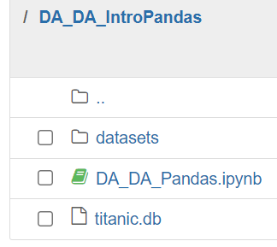
Objectives
import pandas
write a program which uses pandas to
construct a dataframe via reading a dataset
remove missing data
obtain a subset of columns using list indexes

Slide 98
A selection of Python libraries for data analysis
NumPy
fast lists ( aka. arrays)
Pandas
provides single-machine dataframes (aka. tables)
Seaborn & matplotlib
visualization
Spark
query over distributed file systems
plotly
interactive visuals
scipy, sklearn, tensorflow, pytorch, statsmodels
scientific & statistical programming
Aside:
NB. sqlite3 is written in C

Slide 99
Pandas
Trainer DEmonstration

Slide 100
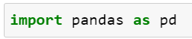
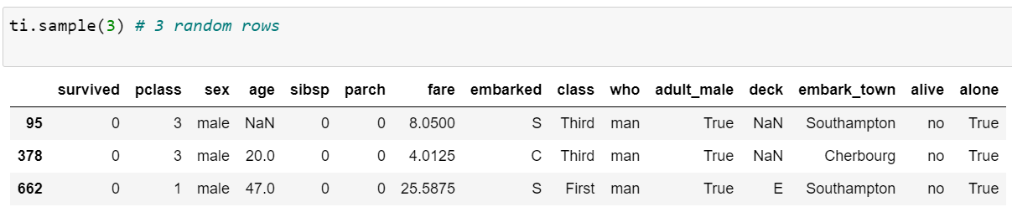
To use the pandas library it first needs to be imported. Here an alias is also used, ‘pd’, to minimise typing/reading later:
It contains read_csv() for loading csv files. This returns an object (not just a single value) called a dataframe that comes with copies of methods for running SQL-like instructions.
Here the object is identified as ‘ti’
The methods (subroutines) that come with the object can be accessed using a dot, eg:
Pandas

Slide 101
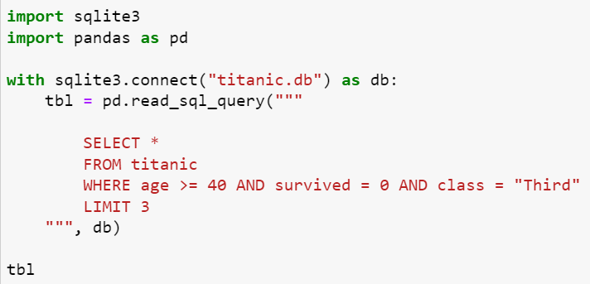
Importing data from a database

Slide 102
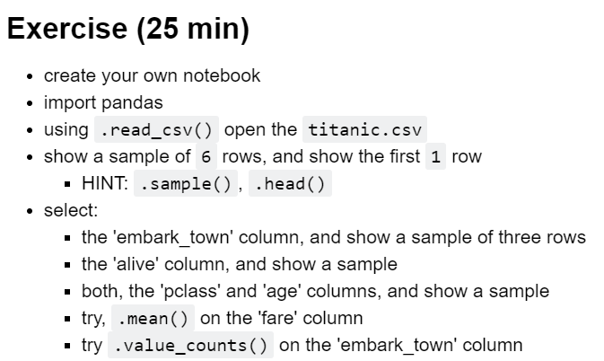
Exercise 1

Slide 103
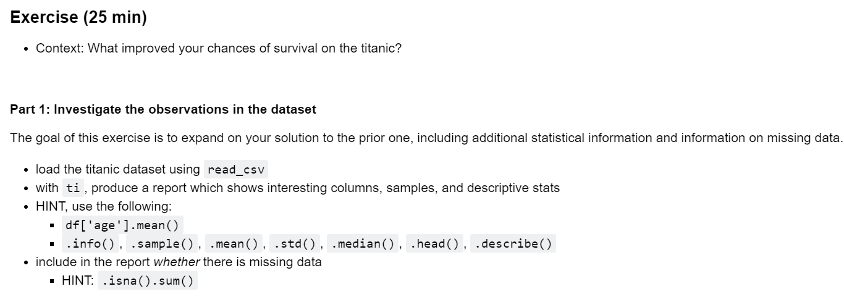
Exercise 2

Slide 104
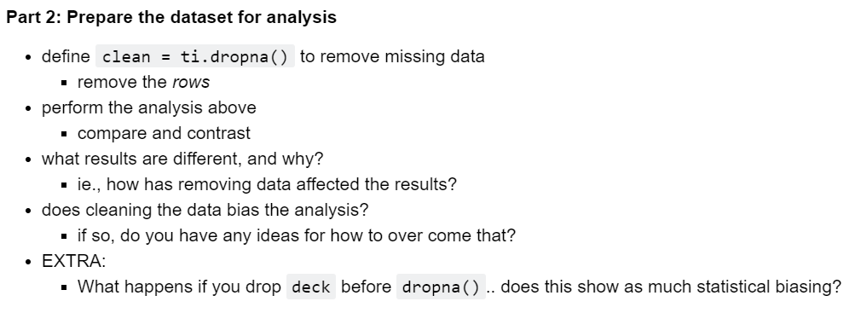
Exercise 3

Slide 105
Learning check
Think about your answers to these questions
How do you load data into Python from a csv? Or from a database?
Can you think of some of the ways to view and manipulate data stored in Python?
What are some methods that might be useful in preparing data before it’s analysed?
If there are any that you can’t confidently answer – please ask for a summary now

Slide 106
End of Module 4

Slide 107
See you tomorrow!
Still to come: Big Data Engineering: Software tools for Big Data Big Data Analytics - Software tools for Machine Learning

Slide 108
Day 2
Big Data Engineering
Module 5: Big Data Choices
Module 6: NoSQL & Mongo
Module 7: Spark & Hadoop
Module 8: Event Systems
Breaks: 11-11.15, 12.30-1.30, 15.00-15.15
or as needed.

Slide 109
Module 5: big data choices
The Topic: What?
A comparison of different data models that could be used for Big Data
Questions that need to be considered in each case to help decide how to choose.
Applications: Why?
To understand what different data models exist
To begin to explore the questions an organisation might need to answer to choose the right tools for them
Expectations: Who?
It is presumed that you work with data

Slide 110
Big data choices
How do analysts choose Big Data techniques and tools?
How do engineers choose Big Data techniques and tools?
How does changing data models help with querying efficiency?

Slide 111
Advantages worth keeping from traditional setups
Relational databases are nearly always the right answer. This is the default -- it is well understood, easy to maintain, highly reliable.
Modern relational databases (eg., postgres) support the relational model AND non-relational models.
EG., postgres supports both document storage; relational storage; and many others including graph models.
Relational databases have been around for decades and are highly optimized, as a rule, any query which works well with a relational database will always be faster with a relational database

Slide 112
Disadvantages of new systems
- Challenges to overcome
What are the disadvantages to non-relational systems?
Almost all "big data solutions" require months to implement (cf., 1 week for relational); highly senitive to configuration, specific querying needs, etc., which are usually poorly understood.
These systems provide counter-intutive "guarentees" around data (, operations); that are quite hard to in practice.
eg., you have a dataset, you have a query; will database X help? Or: why is database Y slow?

Slide 113
Possible data models
-pros and cons
What do you already know about these?
Tabular (relational)
Columnar
Document
Graph

Slide 114
Tabular data model
Relations (ie., tables) in RMDBs support:
fast joining of data
high consistency
transactions

Slide 115
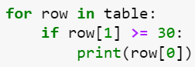
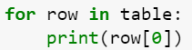
Tabular model
- Query example
A table (saved as a list of rows):
What do these queries do?

Slide 116
Columnar model
EG., Cassandra
The columnar (or column storage) model is essentially relational, in that the basic structure is a table. But tables are stored differently (in RAM or on-Disk).
Subsetting Columns
In analytical (and ETL) workloads we are mostly operating on whole columns, but not all columns at once.
Analysis: eg., user profile db with 1000 columns of demographic/profile/etc. information; for any given query we are looking at, eg., 10 cols.
ETL (Extract, Transform, Load): eg., reformating columns, renaming, copying etc. -- typically to whole columns.
Subsetting Rows (Filtering)
If you need, eg., most columns, but a subset of rows; then a columnar storage is going to be less efficient than the relational alterantive.

Slide 117
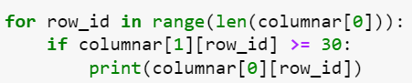
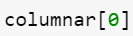
Columnar
- query example
A table saved as a list of columns:
What do these queries do?

Slide 118
Sparcity
EG., MongoDB
Handles sparse data very well, eg.,
collections = [doc1, doc2, doc3]
Each document can differ in its attributes,
doc1 = {'name': ..., 'location': } <- missing age
doc2 = {'name': ..., 'age': ...} <- missing location
Sparcity, def., some significant perctenage of the data elements (observations, cases...) are missing fields that others have.
Each document "has its own schema", and a collection does not impose a common schema.
Document model

Slide 119
Joining
Joining is very expensive in these systems. You are expected ot design these documents, so that they are as hierachical as possible: pre-joining data, then reading all needed data at once.
If you can represent your data as one document (ie., deep hierachy), then you avoid joining: faster. Otherwise: much more expensive.
Rapid Application Development
Documents system are really overused, they often end up requiring lots of joins and being much worse than the relational alterative.
Documents systems, in practice, are used more because they enable Rapid Application Development... when developing software, data is often stored in memory "as a document" -- so using a document db allows developers to quickly "save their application" without writing lots of queries.
Document model (cont.)

Slide 120
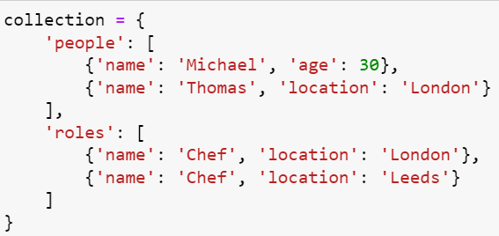
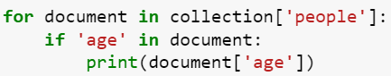
Document model
- Query example
Common query: to check for existence

Slide 121
Graph model
EG., Neo4j (more on this tomorrow)
Relational DB
Suppose we had a relational db with table: people (id, name, age, friend_id)
If we want to find "related rows", we have to have first lookup the target row, and then sequentially query using it's "look up field". Suppose now we want to find all friends of friends....
id -> friend_id -> friend_id -> friend_id ... # ... STOP
It is possible, but very difficult, to work with SQL to do this (CTE, or recursive select query)...
SELECT age, friend_id FROM people AS me WHERE name = "Michael" UNION SELECT age, friend_id FROM people AS friend WHERE id = friend_id
GraphDBs will store data in the ordering of how data is related. So asking for "related data" is just one query

Slide 122
How to choose?
One method:
CAP Theorem:
Consistency
Availability
Partition
Tolerance
How consistent is the data when read?
How does the system make itself available?
How resilient is it to failure?

Slide 123
Critical factors
How do I manage data velocity?
Event systems & streaming.
How do I design applications?
There is a view which says start your design tabular, regardless of how it will end up.
Even with graphs, a table could be (node, node, relationship).
Tables are excellent design tools, and really clarify data structure & requirments.
Once this specification is established, consider the queires, and then how non-relational dbs will help.

Slide 124
Critical factors (cont.)
How do I make a choice for a data solution?
No clear principles.
CAP theorem provides some concerns.
Data model provide query & structure concerns.
Maybe, fortunately, the analyst says "must store images", etc., and then choice is -- roughly -- made.
This is usually rare. Most big data solutions are responses to engineering problems.
Do you have realtime/streaming needs?
Can you batch process data?

Slide 125
The process of choosing
How do you manage this process of choosing?
prototyping, iterative(, agile), sceptical, polyglot, replication
polyglot persistance
using multiple database to store the same data
replication / consistency
process for ensuring multiple dbs are consistently changed

Slide 126
Case study
Case Study: Bank
Batch process which took 6hrs, over night, to complete. On a relational db system. Any new feature, query, etc., would take a small amount of time to development.
Requirement: under half a day to query. So it could be done AM, and reviewed PM.
They "Switched" to a distributed big-data solution (here: spark). This took 6months of development to return to zero-point, eventually, queries across this system were 4hr.
It took 6 months to reduce 6hrs to 4hr, and thef. enable same-day querying. No "magic" has taken place, this is still not fast querying.
New features, new queries, often take much longer to develop in this new system

Slide 127
Storing binary data
Where would you store binary data (eg zip)?
A file system.
Eg Hadoop
hdfs –ls /path/to/my/files
ls /path/to/my/files
Implementing a Hadoop cluster is not straight forward and would require specialist training.
Eg S3 on Amazon
UPLOAD http://myfilesystem.amazon.com/path/to/your/file/data.zip DOWNLOAD MOVE COPY RENAME VERSION

Slide 128
Modern data injestion systems
Three phases
hadoop, file system, querying, batch
lambda architecture
hadoop
streaming / realtime
unified event log
kafka
log = dataset
replication
neo4j
hadoop, s3
many relational dbs, with many copy
almost one db / query
airflow
injestion
stream
case study: https://www.youtube.com/watch?v=nMyuCdqzpZc
event streams in action
designing data intensive applications
Modern solutions: rather than a "whole DB solution" you build your own from pieces.

Slide 129
Starting point for a prototype
What could I build a prototype in?
sqlite3
flat file
postgres -- relational db
document store
graph db

Slide 130
What to avoid at the prototype stage
What should I avoid for prototyping?
jepsen
database simulaton & review
mongodb
data loss
https://aphyr.com/posts/284-jepsen-mongodb
spark <- marketing
2020
GBs, 1TB
dask <- analytical workloads
cloud100s machines vs., 1
can you use grep on a 2TB SSD?
1TB
the worst performing solution:
scaling with dozens of machines
vs., 1TB

Slide 131
activity
Individual activity:
Consider your organisational needs:
What questions do you need to ask to help you decide how to model their data?
What system(s) might be appropriate for their needs? (What training will you and other staff need?)
Estimated Time: 10 minutes

Slide 132
Learning check
Think about your answers to these questions
What are the different data models?
What factors/questions are important to ask when choosing your set up?
How might someone go about prototyping?
If there are any that you can’t confidently answer – please ask for a summary now

Slide 133
End of Module 5

Slide 134
Reminder: Take a break!
11.00 – 11.15
12.30 – 13.30
15.00 – 15.15

Slide 135
Module 6: Nosql and Mongo
The Topic: What?
An introduction to Mongo DB with Python
Applications: Why?
To understand how to use Mongo DB to store and query data using different data models
Expectations: Who?
It is assumed you have used Python previously. This module will focus on how ready-written code can be applied. It is advantageous if you are familiar with user defined records (for which python uses the key word ‘class’). It is advantageous if you have previously been introduced to the concept of APIs.
It is assumed you have worked with data previously. It is advantageous if you have previously used SQL and regex

Slide 136
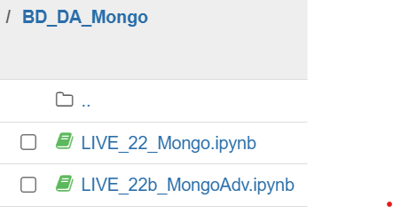
Mongo db and Nosql
Jupyter Notebooks:

Slide 137
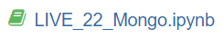
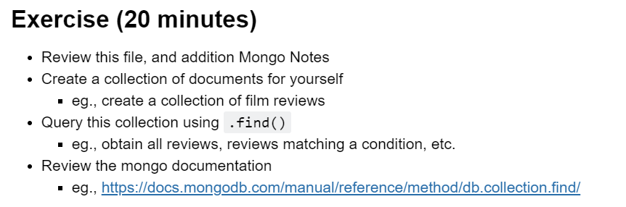
Mongo DB
& document models
- Trainer demonstration
Setting up and introduction to using Mongo DB in Python
Queries in a Document model
Mixed schema example

Slide 138

Mongo DB
- Trainer demonstration
Two conditions for using mongo:
Queries mostly return join'd or hierachical data
Most tables/data is sparse or differenly-structured
Why do people really use mongo?
easy for software engineers to rapidly prototype applications
data model = application model
ie., your objects in db, are your objects in application
no ORM/SQL/etc. translation required
Semi-Strucutrued
Collections of Documents
Each Document can have a different schema
You can query for documents matching a certain schema
Queries
Document templates
Find matching documents
Match on:
fields existing
regular expression on values(, on fields ?)
fields having certain values
Aggregates & Group-Bys

Slide 139
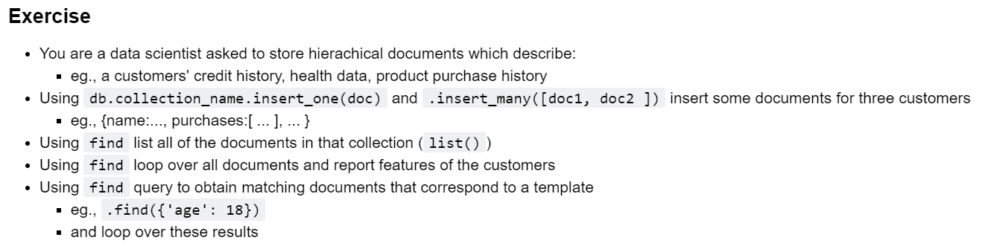
exercise

Slide 140
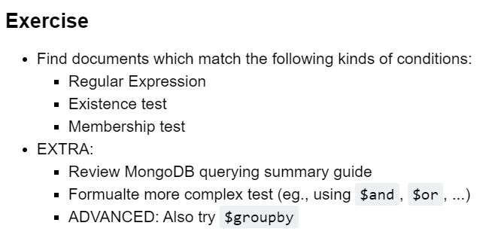
exercise

Slide 141
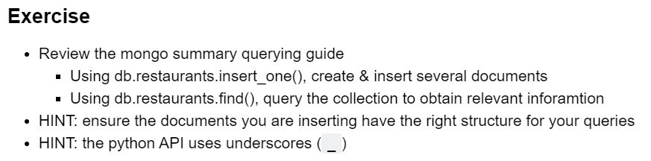
exercise

Slide 142
activity
Individual activity:
Consider your organisational needs:
What questions do you need to ask to help you decide how to model their data?
What system(s) might be appropriate for their needs? (What training will you and other staff need?)
Estimated Time: 10 minutes

Slide 143
Learning check
Think about your answers to these questions
Why do people use Mongo?
Why isn’t SQL needed?
What/how can queries be written?
If there are any that you can’t confidently answer – please ask for a summary now

Slide 144
End of Module 6

Slide 145
Reminder: Take a break!
11.00 – 11.15
12.30 – 13.30
15.00 – 15.15

Slide 146
Module 7: spark and hadoop
The Topic: What?
An introduction to distributed file systems and how to query them (an alternative to relational databases)
Applications: Why?
To understand when and how there is a need to have a non-relational model
Expectations: Who?
It is assumed you have worked with data previously.

Slide 147
Spark and hadoop
Objectives:
import the pyspark v.2 library
connected to a spark instance
read & parse a csv file
write a select query:
over all columns
over a subset of columns
over two tables
filters by rows
subsets rows and aggregates
EXTRA: write and use a python user-defined function in SparkSQL

Slide 148
Distributed computing
With spark, datasets are distributed over a large number of machines in a file-system-like way. This set of machines ("cluster") behaves like a single file system.
Contrast this with a database where a schema is typically imposed on all datasets.

Slide 149
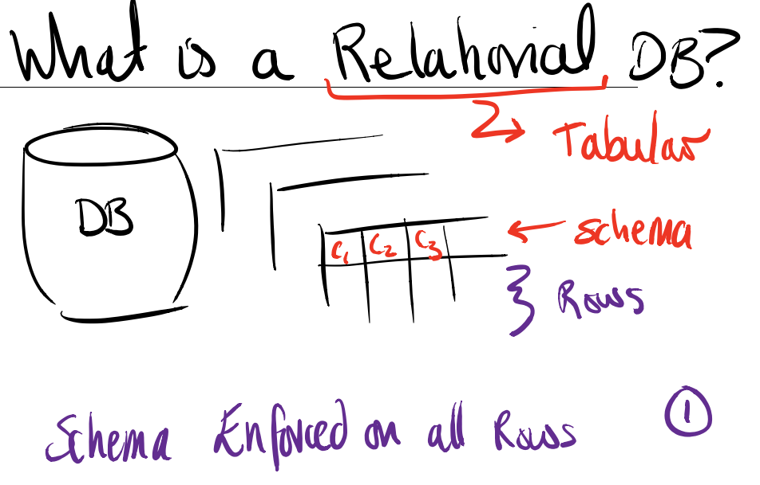
Relational system

Slide 150
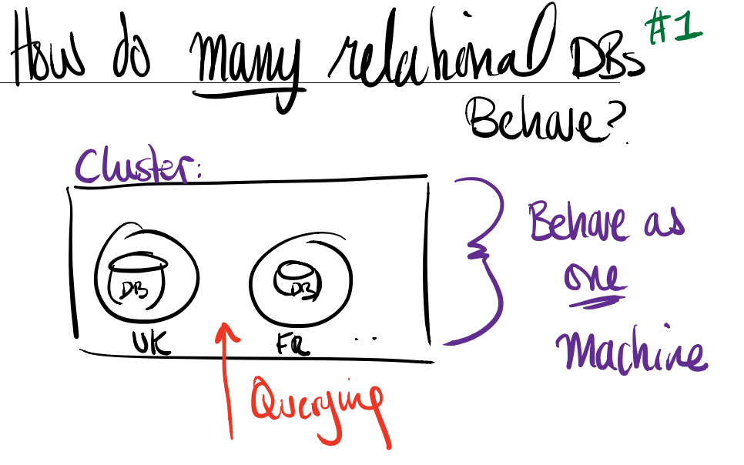
Multiple relational databases
(1 of 2)

Slide 151
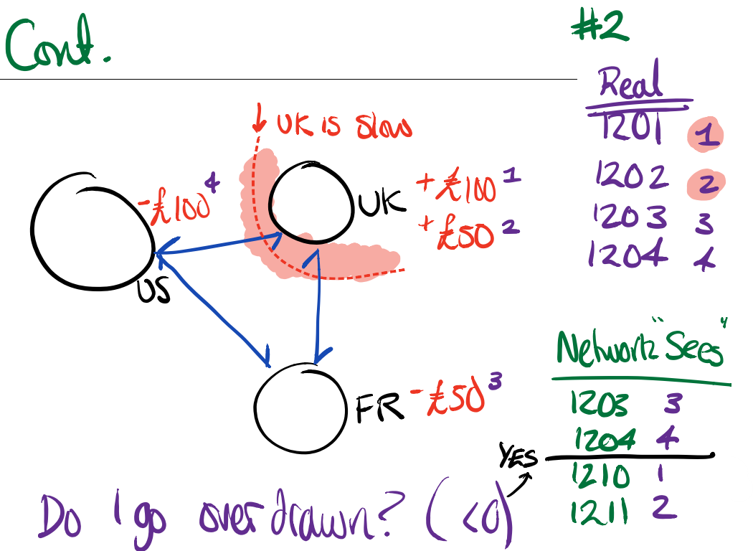
Multiple relational databases
(1 of 2)

Slide 152
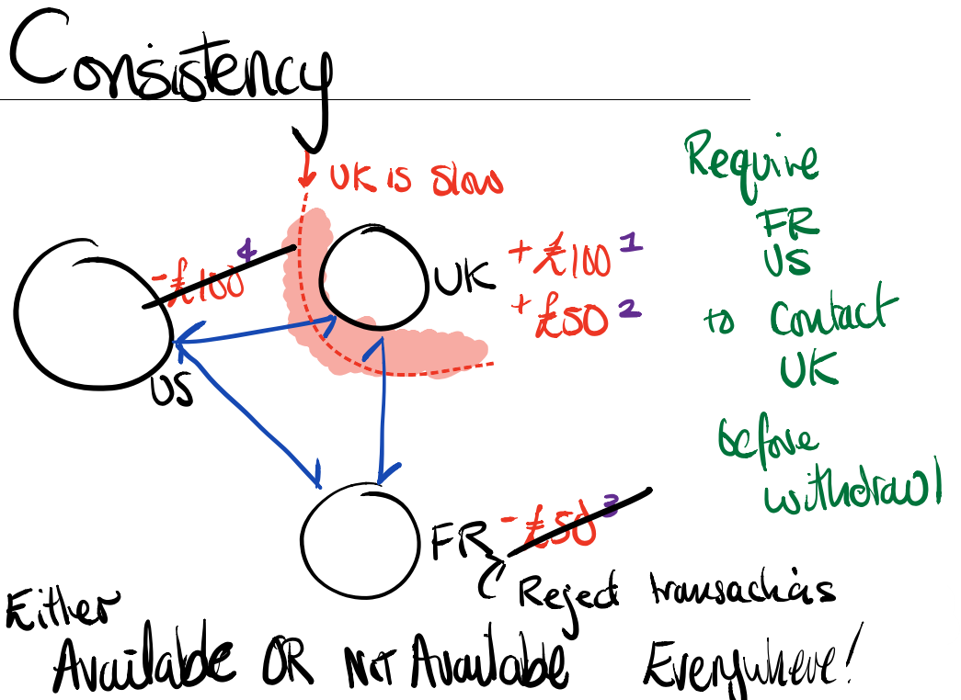
consistency

Slide 153

Consistency vs availability

Slide 154
Relational databases in summary
Relational database management systems are:
Tabular
Consistent
So what is a distributed file system and why would it be used?

Slide 155

Distributed file system

Slide 156
Why distribute computation?
When the data does not fit on a single machine.
Two situations:
doesn't fit into RAM and needs to
eg., image processing
doesn't fit into solid disk
eg., massive datasets
RAM
apple.com Mac Pro, 2TB
amazon.com buy 256gb *4 = 1TB
Hard/Solid disks
Seagate 16TB IronWolf -- a single 16TB disk
easily have many disks, so, 1PB
NB. These numbers are different today, than ten years ago. eg., 100GB+

Slide 157

The need for distributed file systems

Slide 158
Why should I not distribute computation?
If a query can be performed on a single machine, it is almost always faster to do so.
When dealing with distributed querying, you require machines to synchronize over a network -- and to cooridinate, etc., and this typically imposes high initial costs / query.
NB. always prototype systems first, and experiment with query performance before selecting complicated solutions.

Slide 159

Challenges
For Dist. fs

Slide 160

Need consistency eventually

Slide 161

Consistency example

Slide 162
Introducing spark
What is Spark?
a system
a means of distributing data across a large number of machiens
a means of querying across these
assuming no underlying data structure
a library, pyspark
for using this system
two programs which implement the system
executor program
runs on all data machines
program which runs queries
driver
runs on developer machine (, laptop, etc.)
sends queries out

Slide 163

Querying a dist. fs

Slide 164

How does spark work?

Slide 165

Spark
- Trainer discussion
How to try Spark without installation
Comparing Spark to traditional installations
How is Spark used by your organisation?
Problems
datasets in spark are much larger than your RAM
pulling in datasets into pandas/python
WARNING: pandas is for working on a single-machine,
PySpark is sometimes offered versioned
so that certain capabilities are disabled
& official documentation therf. may not be reflective

Slide 166

Exercise
Estimated time: 25 minutes

Slide 167

When do you need scale?

Slide 168
Learning check
Think about your answers to these questions
What’s the difference between relational DBMS and a distributed file system?
Why are distributed file systems used and what challenges need to be considered?
If the default system should be a relational DBMS, when would you need to switch to a distributed file system?
If there are any that you can’t confidently answer – please ask for a summary now

Slide 169
End of Module 7

Slide 170
Reminder: Take a break!
11.00 – 11.15
12.30 – 13.30
15.00 – 15.15

Slide 171
Module 8: event systems
The Topic: What?
An introduction to event systems and logs
Applications: Why?
To understand what these are, what benefits they bring, and how to implement them.
Expectations: Who?
It is assumed you have used Python previously.
It is assumed you have worked with data previously and are familiar with non-relational database storage concepts.

Slide 172
Intro to event systemts
Starter: Responsive Systems – what do you think?
- How do I design a data system to be responsive?

Slide 173

What is an Event?
Any "row" (observation, case, example)... which has the following properties:
subject
verb
object
Context
Pretty much any piece of data can be represented as an event.
What is an Event System?
Any system for which the primary data element is an event (as defined above).
Event and streaming basics

Slide 174
Streaming and stream processing
What is Streaming and Stream Processing?
Streaming is a technical term which means using a constant amount of memory to process a large amount of data.
Here, "streaming" denotes that we process one event at a time... across a whole "stream" of events.

Slide 175
Append-only logs
What is an append-only log?
An append-only log is just one possible system to record an event stream.
Typically an event stream is only "live" over some window of time, eg., you "live" event stream has only 1day of events; here the log is cleared daily.
An append-only is a system of accept raw unprocesed events, typically over a window of time, "verbtaim" without editing or deleting.
This log is then replicated to serve for later or offline processing (& archiving).

Slide 176
Append-only logs
How is an append-only log structured?
Events are sequenced in time, so that later events in log occur later.
"Archived logs" have the same structure, so you can use the same tools to process a live and archived log.
Reprocessing an archived log is known as "replaying", and this is extremely conveient way of fixing mistakes (& reprocessing data etc.).
Why does this seem simple?
This is deceptively simple, compare with a database, and you CANNOT:
edit
delete
And , with a relational db, "rows" are thought of as highly structured and not ordered.
Event logs are ordered in time, uneditable, weakly structured (subject, verb, object, at).
The limitations are vital!

Slide 177
Event bus and event log
What’s the difference between an event bus and event log?
An event bus is an internal signalling and coordination system for managing internal services. The data in a event bus, is generated by internal systems and is mostly formatted as "call function with these argumnts".
An event log is a database, it's where the data is. It's not, primarily, a coodination mechaism. The data in an event log is generated by customers (or sensors, or any external systems). They can be use a bit like an event bus to coordinate, but this is a secondary use: most of the data in them is externally generally generated.

Slide 178

Applications
Trainer demonstration
(Part 2)
Implementing an event stream
Log processing
What do processors normally do with events?
Noramlize and insert into database
Insert derived event into a different event stream
(Also, possibly, email user)
Typically there is a "Raw" or primary stream whose events are always generated externally. This stream is just processed into new streams or derived data.
And typically, "actions" such as emailing a user, are executed on a derived stream. So that the "raw" stream is just a "vertaim record".
Anomaly detection

Slide 179
tools
What’s the leading tool for recording event streams?
Kafka
What tools are there for processing event streams?
confluent (by the kafka people)
spark
kinesis

Slide 180
Log systems uses
Why are event log systems useful?
ready for analysis
forces you to record history of:
who caused data injest
where did come from
when
context
this makes your life so much easier, even if you don't need this right now!
esp. for debugging as every record of data has a subject!
eg., the email system records itself as what caused an INSERT

Slide 181
Example: Cart abandonment
Trainer demonstration
(Part 4)
Customer adds items and orders, but abandons the basket.
A log processor watches the event stream to see when a customer first started browsing, and when their last interaction was.
If the event processor finds a last-interaction more than 30min from when it's looking, it generates an "ABANDONED_BASKET" event.
A second system monitors for abandoment-events, and triggers emails to remind customers they have products in their basket (ie., to increase sales).

Slide 182
activity
Group discussion
Consider your organisational needs:
Does your organisation already use a system like this do you think?
What use could they make of it to achieve their organisational objectives?
Estimated Time: 10 minutes

Slide 183
Learning check
Think about your answers to these questions
What are event systems?
What can they be used for?
If there are any that you can’t confidently answer – please ask for a summary now

Slide 184
End of Module 8

Slide 185
See you tomorrow!
Still to come: Big Data Analytics - Software tools for Machine Learning

Slide 186
Day 3
Big Data Analysis
Module 9: Big Data Analysis & Machine Learning
Module 10: Graph Analytics & Neo4j
Breaks: 11-11.15, 12.30-1.30, 15.00-15.15
or as needed.

Slide 187
Module 9: Big data analysis and machine learning
The Topic: What?
An introduction to AI and Machine Learning
Applications: Why?
To understand what these are, what the different types are and some examples of what they are used for.
Expectations: Who?
No prior knowledge is assumed.

Slide 188
objectives
What do you need to know?
Context: the goal of machine learning / artificial intelligence
Methodology: algorithms and how they are put into practice
Maths and Statistics
Python and Machine Learning Libraries

Slide 189

context

Slide 190

Types of ai

Slide 191

Types of problems

Slide 192

Open problems

Slide 193

Open problem example
Open problem: What can I do?
… buttons… lights (on/off)… oven (temp)… chairs… control devices…

Slide 194
Goal of ai
To have techniques when other simple techniques fail
So what’s the difference with machine learning?...

Slide 195

Machine learning

Slide 196

ML example
Goal: we want a formula that works out the light intensity if we know the dial level.

Slide 197

ML example (cont.)
Goal: we have the formula (multiply by 3, then add 1), we should include a margin of error though.
Errors are based on the starting data set: difference between the calculated and actual y coordinates… could then work out what a ‘typical’ error might be.

Slide 198

discussion
What could the formula be? (How do get from x to y)
Normally data analysts would plot it to see what shape the graph would be… but there are only 3 points – it could be anything!

Slide 199

Which has the smallest errors?
There are so many models that could give an answer – a data scientist can help narrow down, analyse and choose the best one.
Machines may be required to infer a model (eg neural networks)
Some thoughts on the example

Slide 200
Machine automation
What is machine automation?
automation
accuracy
performance
productivty
programming
using computational algorithms to make "intelligent" decisions
machine learning, AI

Slide 201

algorithms
What is an algorithm?
set of instructions (, rules)
inputs
(optional) outpts
decisions
statistical algorithm
elements derived from data

Slide 202
Computational models
What is a computational model?
computational model
set of available instructions
rules which use these
What inputs can an algorithm take?
take inputs from the user
take datasets input
apply mathematical options
statistical operations
non-deterministic (uncertainty)

Slide 203
Artificial intelligence
What is AI?
Augmented
def., ?, reinforcing what we have...
def., building upon active human intelligence
dr using a diganostic system
Assistance
def., ?
Artifical Intelligence
vs., Augmented
vs., Fully-Automated
live image processing (zoom call... background blur)
What is AI?
why are algorithms important?
Machine AI
{IF, IF, IF, IF, ELSE, ELSE}
Applications
Imagine Processing
Promise of AI (Hyped):
replace the human mind

Slide 204
Weak vs strong ai
What is Weak or Strong AI?
Weak, def., any system which can replace a human on a specific task which, in humans, requires intelligence
Strong, def., any system which can replace a human on general problems which, in humans, requires intelligence
eg.,
child holding a door open -> replace child with rock
person sorting mail -> mail sorter
read, geography... -> photographs of postcodes TO bins
Strong is about skills eg.,
a bike rider (, doctor, programmer) can ride across all terrains well, (swim, acrobatic, dexterous, local directions...)
skill acquistion is not problem-specific

Slide 205
What makes a system safe to use?
ORDER: turn an oven on
causal reasoning
what are the concequence of my actions?
what specific effect does a specific action have?
counterfactual reasoning
a human being considers possibilities
what would happen if the oven were turned on?
what would happen if I ignored the order?
what would happen if I made a mistake?
what was the intention behind the order?
vs., y = f(x) = ..
if y > 0.5, turn oven on, else off
generalised interaction capacities
machines have highly restricted input/output boundaries
keyboard, etc.
a person may have to:
look at the oven
look around the kitchen
shout to the commander
warn people around the oven
...pick up knife (maybe its in the over)
self reflection
if i fail to turn the oven on, why was that?
let me try again, with the relevant change
does that work etc.
Machine learning ethics

Slide 206
Improving ml safety
How do we improve the safety of ML?
ensure, by human inspection & control, the environment has no potential faults
explicitly program control system (non-ML control systems)
the datasets observe events which are identical in kind to the events likely to occur
include a human operator to review decisions
BEST CASE:
use system where approximate and even wrong answers are OK

Slide 207
Retail
supermarket -- regression
predict profit from a marketing campaign
predict profit increase from changes to store layout
predict sales increase from discounting strategy
clothes
classify product into best sales location (Leeds, Manchester, London)
classify customer into demographic (YoungRich, MiddleUnemployed, ...)
classify store into HighPerforming, LowPerforming
Health
sleep -- classification
classify sleep into High|Low|Clinical quality
diet -- regression
predict weight loss from diet plan
Product Recommendation
films
classify film into Like|Dislike for a user
and thereby recommend a film
ecommerce
predict customer rating for product
Social & Political
political campaign
classify voter into LikelyVoter|NotLikelyVoter
classify voter into LabourLeft|LabourRight|LibDem|Consv...
social networks
predict number of friends from behaviour on social network
Eg., Behavioural Data:
classify /predict ... from User Behaviour Events
eg., clicks, purhchases, mouse movements, file saves…
Business applications for ml

Slide 208
Types of ml
Supervised
Regresssion
y : profit, from x : (
Classification
Unsupervised
Compression
Clustering

Slide 209
activity
Kaggle: https://www.Kaggle.com
Allows users to find and publish datasets, explore and build models in a web-based data-science environment, work with other data scientists and machine learning engineers, and enter competitions to solve data science challenges. [Wikipedia]
Datasets
Notebooks
Professional Solutions to Problems
Beginner Tutorials
Kaggle has an open (apache 2) licence, which means, typically, everything is usable for most reasons (eg., commerical, private, etc.)
Notebooks are apache 2 by default, and datasets have a licence given on their page (often CC-BY-SA = fine if referenced).

Slide 210
Reminder: Take a break!
11.00 – 11.15
12.30 – 13.30
15.00 – 15.15

Slide 211
Q1. Find some datasets
Data Tab > eg., "Sleep"
eg., https://www.kaggle.com/danagerous/sleep-data
Choose one or more of the problem domains above
find a dataset
write down the columns contained in that dataset
what is the prediction target 𝑦y ?
what are the features 𝑥x ?
Q2. Find some beginner tutorial notebooks
Find a beginner notebook on a topic of interest and review
Visualization, Data Science, Python, Sleep, Social Networks...
https://www.kaggle.com/notebooks
filters > tag > "beginner"
eg., "Machine Learning"
https://www.kaggle.com/kanncaa1/machine-learning-tutorial-for-beginners
eg., "Visualization"
https://www.kaggle.com/benhamner/python-data-visualizations
Q3. Find some professional notebooks
eg., find competition submissions
Activity
Estimated time: 25 minutes

Slide 212

Demonstration
- Trainer demonstration
More detail about libraries and packages in Python
Using:
NumPy
Pandas
Seaborn
MatPlotLib
SKLearn
Tensorflow
Networkx

Slide 213

Exercise

Slide 214

exercise

Slide 215
activity
Group discussion
Consider your organisational needs:
Does your organisation already use AI or ML?
What use could they put these to to achieve their organisational objectives?
Estimated Time: 10 minutes

Slide 216
Learning check
Think about your answers to these questions
Could you explain the difference between AI and ML?
What can they be used for?
If there are any that you can’t confidently answer – please ask for a summary now

Slide 217
End of Module 9

Slide 218
Reminder: Take a break!
11.00 – 11.15
12.30 – 13.30
15.00 – 15.15

Slide 219
Module 10: graph analytics and neo4j
The Topic: What?
An introduction to graphs and networks – how abstract data types can be represented in Python
Graph models for relational data eg Neo4j
Applications: Why?
To understand what these are, what benefits they bring, and how to implement them.
Expectations: Who?
It is assumed you have used Python previously.
It is assumed you have worked with data previously and are familiar with relational and non-relational database storage concepts.

Slide 220
Introduction to graph theory and network science
Learning Aims
What is a graph?
Basic terminology
nodes, edges, weights, degree, directed vs undirected
Graph representations
node-link, edge lists, matrices
Learning Objectives
Build and examine a graph in NetworkX
from basic edge lists
including: edge weights node info, and different node types.
Use NetworkX to construct graphs from a given sample data set
Obtain information from graphs using NetworkX functions
Use NetworkX and Matplotlib to visualise graphs.
given a graph, produce a variety of output images demonstrating various layouts and levels of labelling

Slide 221
graphs
What is a Graph?
Relationships beteween nodes, g
In typical data analysis rows (observations, examples) are analysed in terms of the columns (features, fields, attributes) of which they are composed.
In network analysis rows (or "nodes") are analysed in terms of their relationships to other rows ("nodes"). The transition to the analysis of networks therefore requires a totally different way of thinking.
In the world of networks the relationships are more important than the attributes of the individuals.

Slide 222

Graph terminology

Slide 223

Graph structure

Slide 224
Types of graph
Some examples:
Undirected
Directed
Weighted

Slide 225

Undirected graphs

Slide 226

Directed graphs

Slide 227

Weighted graphs

Slide 228
Things to consider when evaluating examples
Nodes
Node Classes (Types)
Undirected Edges
Directed Edges
Paths
Weights
Clusters (Grouping)
Node Centrality (Size)

Slide 229

exercise
Compete the descriptions of the following networks:
What do you think a node, edge, weight could represent?
What does the node centrality (size, importance) represent?
What would a path describe?
What would cause clustering?

Slide 230

Example: Social networks 1
Facebook Users at Northwestern University
Nodes
Node Classes (Types)
Undirected Edges
Directed Edges
Paths
Weights
Clusters (Grouping)
Node Centrality (Size

Slide 231

Example: social networks 2
Film-Actor Network via IMDB
Nodes
Node Classes (Types)
Undirected Edges
Directed Edges
Paths
Weights
Clusters (Grouping)
Node Centrality (Size)

Slide 232

Example: social networks 3
Tweets in the US 2010 Election
Nodes
Node Classes (Types)
Undirected Edges
Directed Edges
Paths
Weights
Clusters (Grouping)
Node Centrality (Size)

Slide 233

Example: transportation networks
US Air Transport Network
Nodes
Node Classes (Types)
Undirected Edges
Directed Edges
Paths
Weights
Clusters (Grouping)
Node Centrality (Size)

Slide 234

Example: Biological networks
Connectome of a Roundworm
Nodes
Node Classes (Types)
Undirected Edges
Directed Edges
Paths
Weights
Clusters (Grouping)
Node Centrality (Size)

Slide 235

Representing graphs
Graphs are an abstract datatype – that is, they are useful for humans to picture how the data is connected and interacts, but it isn’t typically in a format that a machine can store it without some other way of representing the information.
Some notation:

Slide 236


Representing graphs: adjacency matrix

Slide 237

Adjacency matrix (cont.)

Slide 238


Python Representation
Adjacency matrix (cont.)

Slide 239


Representing graphs: edge list

Slide 240

Edge list (cont.)

Slide 241



Python Representation
Edge list (cont.)

Slide 242


Representing graphs: adjacency lists

Slide 243



Python Representation
Adjacency lists (cont.)

Slide 244
Part 1 (5min)
On a piece of paper, draw a network.
Choose a problem domain of interest
eg., retail, transport, social, comms, ...
Choose a kind of object to model as a node
eg., node = person
Choose a directed (asymmetric) relationship between them
eg., A-likes->B
Choose a numerical weight which makes sense for this type of relationship
eg., length of friendship, frequency of...
Draw a graph from your above decisisons which:
includes 5 nodes
where at least one node has 2 or more edges
at least one node has no edges
Part 2 (15min)
On paper, Represent this graph as:
Adjacency Matrix
Edge List
Node/Adjancy List
Extra / Part 3 (15min)
write python code using lists and dictionaries
compute the total weight of all edges in your graph for all representations
(ie., add together all the weights)>
Exercise
Estimated time: 35 minutes

Slide 245
Reminder: Take a break!
11.00 – 11.15
12.30 – 13.30
15.00 – 15.15

Slide 246


Graph models for Relational Data in Python
Visualising Networks
Demonstration: Graph modelling
- Trainer demonstration

Slide 247
Exploring Neo4j:
Investigate what Neo4j is and find an example of how it can be used.
Share your findings with the group.
Activity
Estimated time: 15 minutes

Slide 248
Learning check
Think about your answers to these questions
What is a Graph database?
Can you describe how a graph database could be set up and accessed?
What can they be used for?
If there are any that you can’t confidently answer – please ask for a summary now

Slide 249
End of Module 10

Slide 250
Let’s Review

Slide 251

What Are You going to …
..Stop?
..Continue?
..Start?

Slide 252
Future Course options and Support
Developing these skills further:
https://www.qa.com/training/courses/data/data-science-and-ai/
Practical Big Data Analysis: QADMSPBDA Python: QADMPPDS R: QADMPFR Statistics: QADMMFST Machine Learning: QADMSFML As well as a range of exam assessed training.

Slide 253
What Did you Think?
https://evaluation.qa.com
Course code:
QA…
PIN:
4………-…

Slide 254
Congratulations and Thank You
You will receive your course attendance certificate via email

Slide 255
Leaving the session?
Click FILE > Leave Training Session

